Slide 1
Numerical Approximation of Electromagnetic Field Integral in a Transmission Line
GROUP 8
GROUP LEADER: VICTOR G. AHMEDU
LECTURER: ENGR. DR. JAMES G. AMBAFI

Slide 2
Introduction & Problem Statement
Background: Transmission lines produce magnetic fields that can cause electromagnetic interference (EMI).
Problem: Analytical integration is often impractical for complex conductor geometries.
Objective: Apply and compare Composite Trapezoidal and Simpson’s Rules to estimate field strength

Slide 3
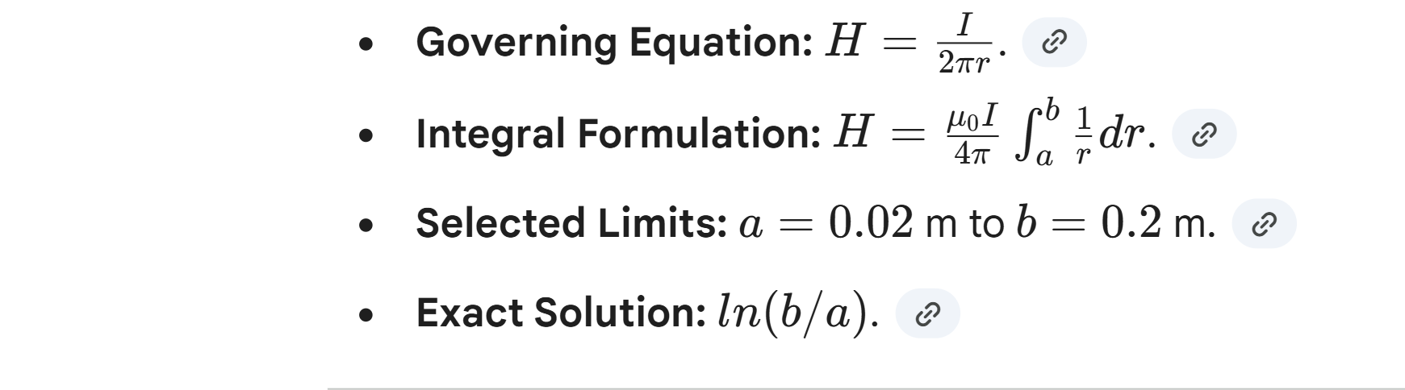
Mathematical Modelling

Slide 4
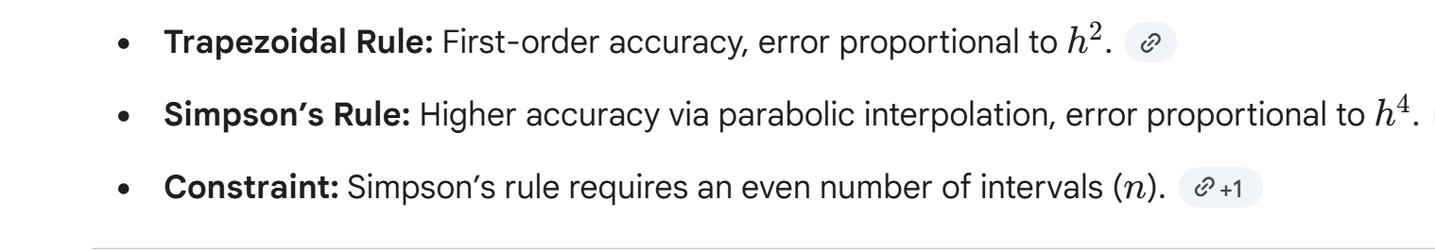
Numerical Methods Selection

Slide 5
Algorithm Design
Steps:
Define function
Set limits (a,b)
Calculate step size h
Iterative summation of interior points
Apply method-specific weights

Slide 6
MATLAB Implementation & Results
Simulation Parameters: n=10, a=0.02, b=0.2.
Results from Command Window:
Exact: 2.302585
Trapezoidal: 2.365214
Simpson: 2.311978

Slide 7
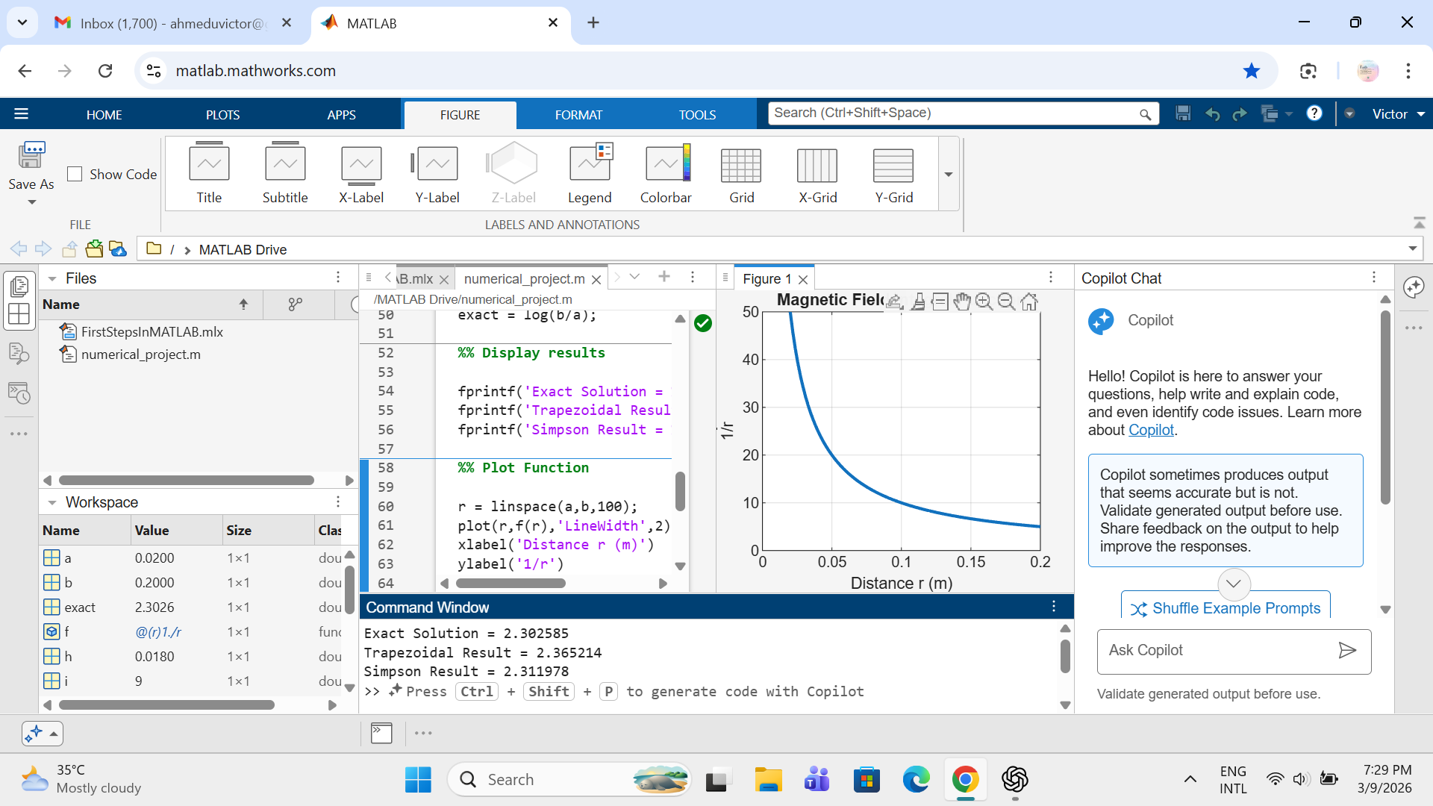
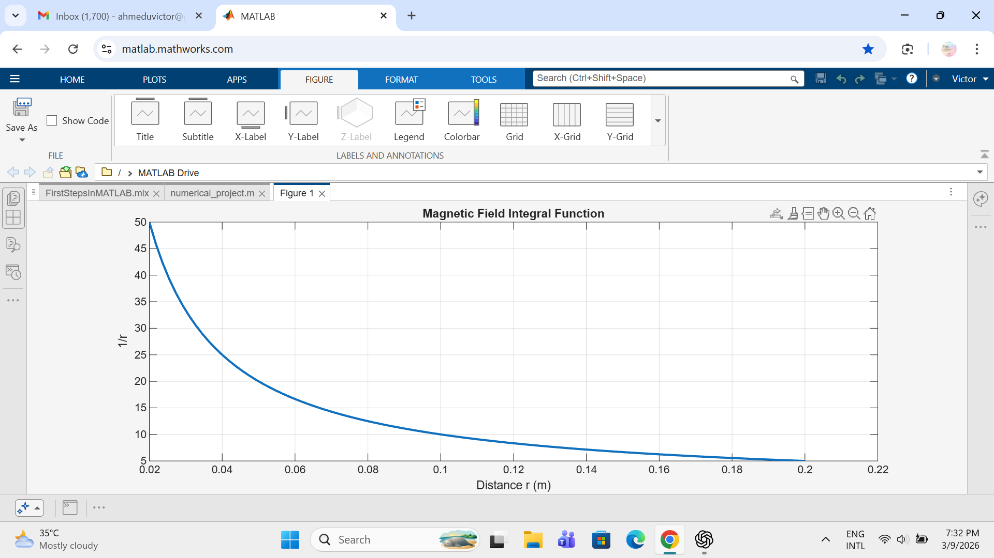
MATLAB Implementation & Results

Slide 8
The plot illustrates the inverse relationship between distance (r) and field intensity (1/r).

Slide 9
Engineering Interpretation
EMI Mitigation: Field strength decreases rapidly with distance; adequate spacing is critical for sensitive equipment.
Design Insights: Accurate numerical estimation helps in positioning communication cables and designing transmission corridors.

Slide 10
Conclusion & Recommendations
Conclusion: Numerical methods effectively solve electromagnetic field problems where analytical solutions are difficult.
Key Finding: Simpson’s rule provides superior accuracy for precision engineering tasks.
Recommendation: Use Simpson’s Rule for high-precision simulations; maintain strict spacing standards to reduce EMI.

Slide 11
REFERENCES
[1] S. C. Chapra and R. P. Canale, Numerical Methods for Engineers, 7th ed. New York, NY, USA: McGraw-Hill Education, 2015.
[2] K. E. Atkinson, An Introduction to Numerical Analysis, 2nd ed. New York, NY, USA: John Wiley & Sons, 1989.
[3] W. H. Press, S. A. Teukolsky, W. T. Vetterling, and B. P. Flannery, Numerical Recipes: The Art of Scientific Computing, 3rd ed. Cambridge, U.K.: Cambridge University Press, 2007.
[4] S. J. Chapman, Electric Machinery Fundamentals, 5th ed. New York, NY, USA: McGraw-Hill Education, 2012.
[5] MathWorks, “Numerical Integration in MATLAB,” MathWorks Documentation. [Online]. Available: https://www.mathworks.com/help/matlab/

